Slide 1





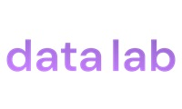


Big thank you to our great sponsors

Slide 2
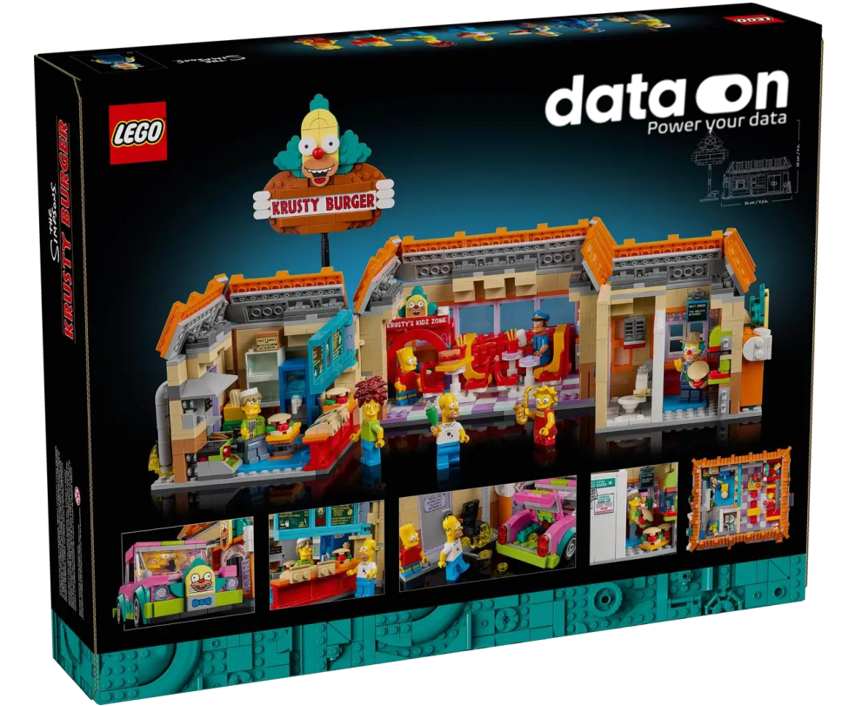
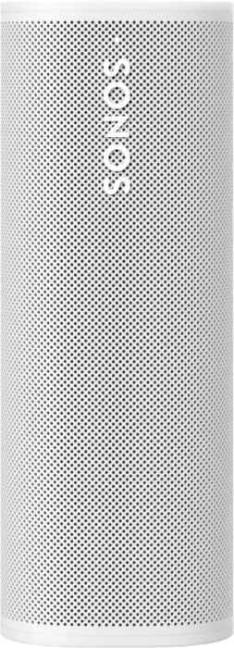
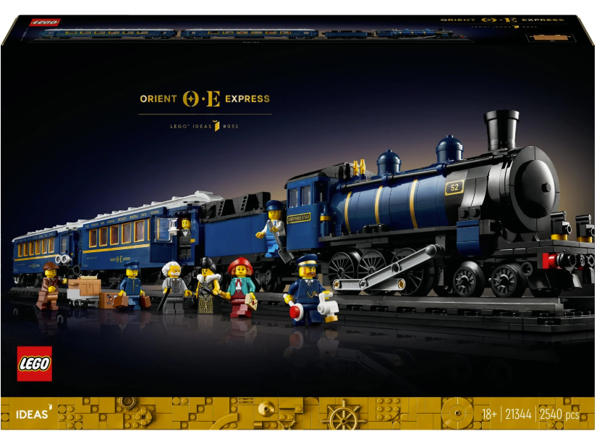
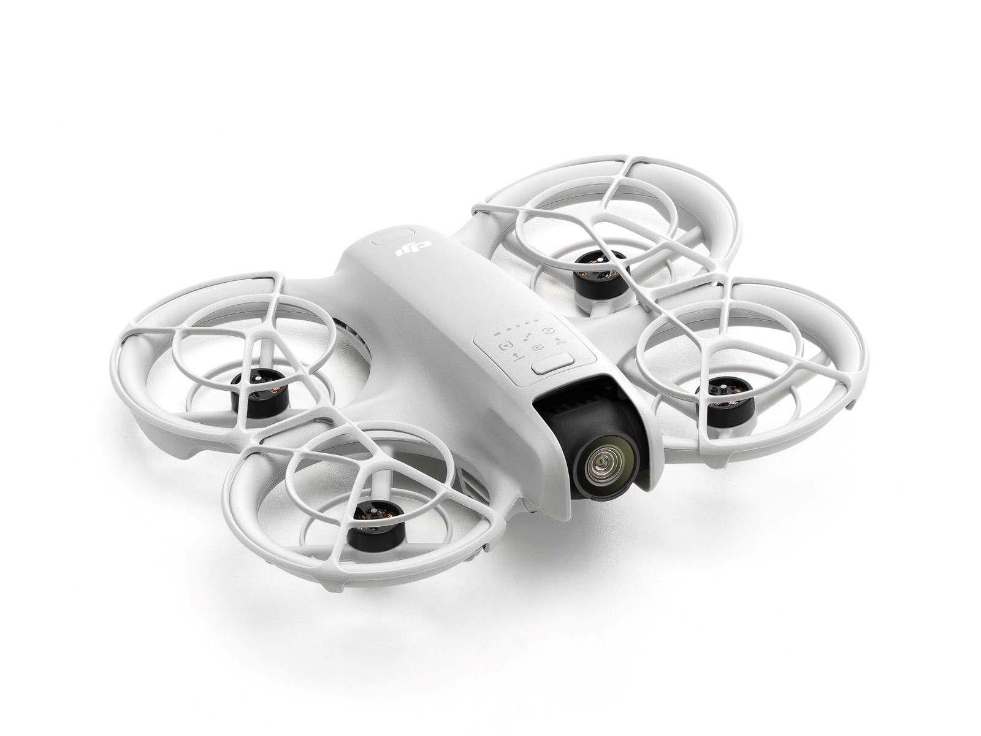
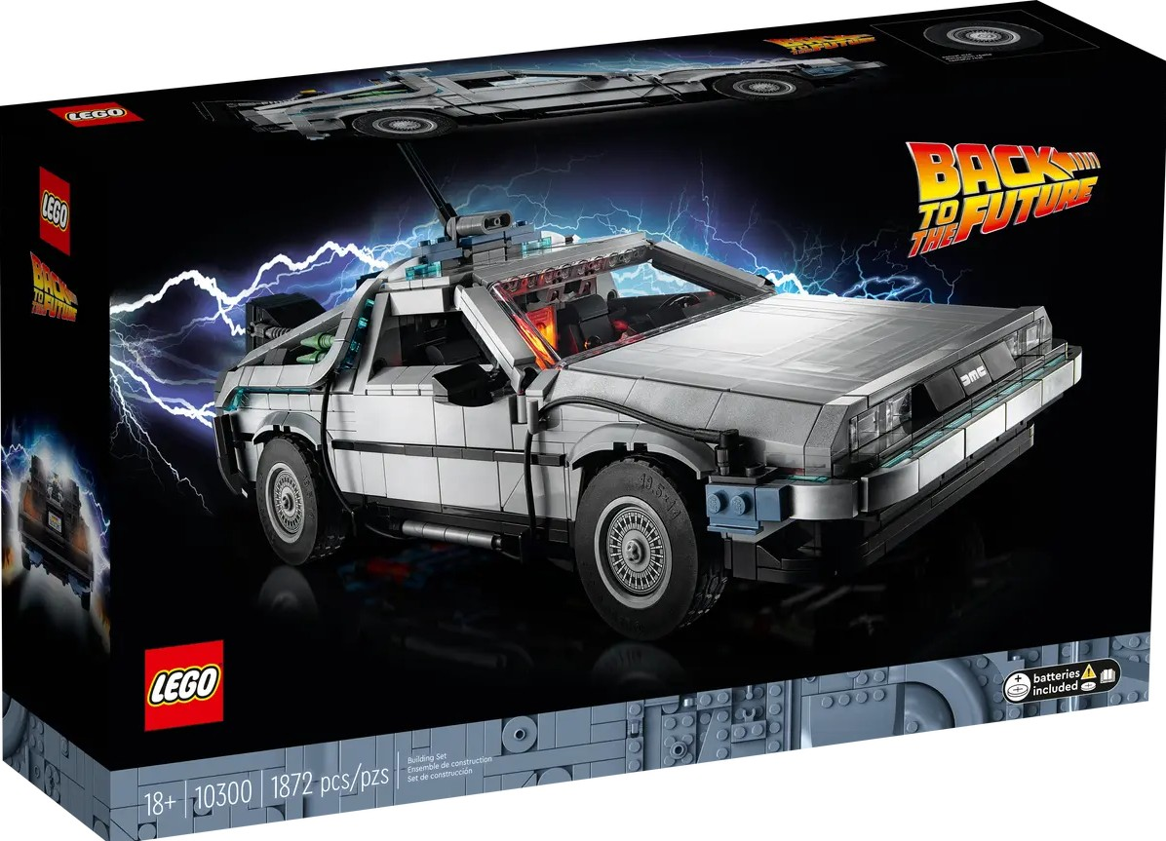

Raffle prizes from the sponsors

Slide 3

Demystifying DAX UDFs
Power BI Next Step September 23rd, 2025
The Future of Reusable Business Logic

Slide 4

About me
Daniel Otykier
CTO @ Tabular Editor ApS
6x Microsoft MVP
Power BI Contributor
Hates duplicated code

Slide 5
Agenda
Why DAX UDFs?
How do they work?
Understanding parameters
Creating and using UDFs
Power BI Desktop
External tools
Practical examples
Community innovation

Slide 6
Why DAX UDFs?
DAX is simple but it’s not easy
Until now, complex logic had to be expressed in measures
Measures can reference other measures, but…
Measures can only return scalar values (Int64, Float, DateTime, String, etc.)
A measure in a specific filter context always returns the same result (no parameters)
Calculation groups permit some logic reuse across all measures, but…
Requires user selection
Complex code needed to limit logic to some measures only
May cause data type decay which breaks some visuals
Performance hit
Most other languages let you define your own functions; M, Python, SQL, even MDX.

Slide 7
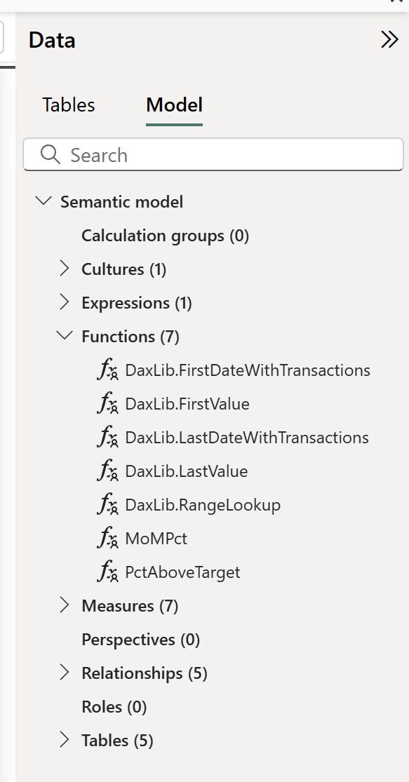
Enter DAX User-Defined Functions
First class model object (“Function”)

Slide 8
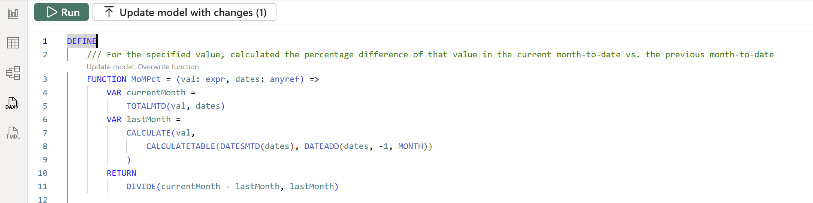
Enter DAX User-Defined Functions
First class model object (“Function”)
Can be created through…
DAX Query view

Slide 9
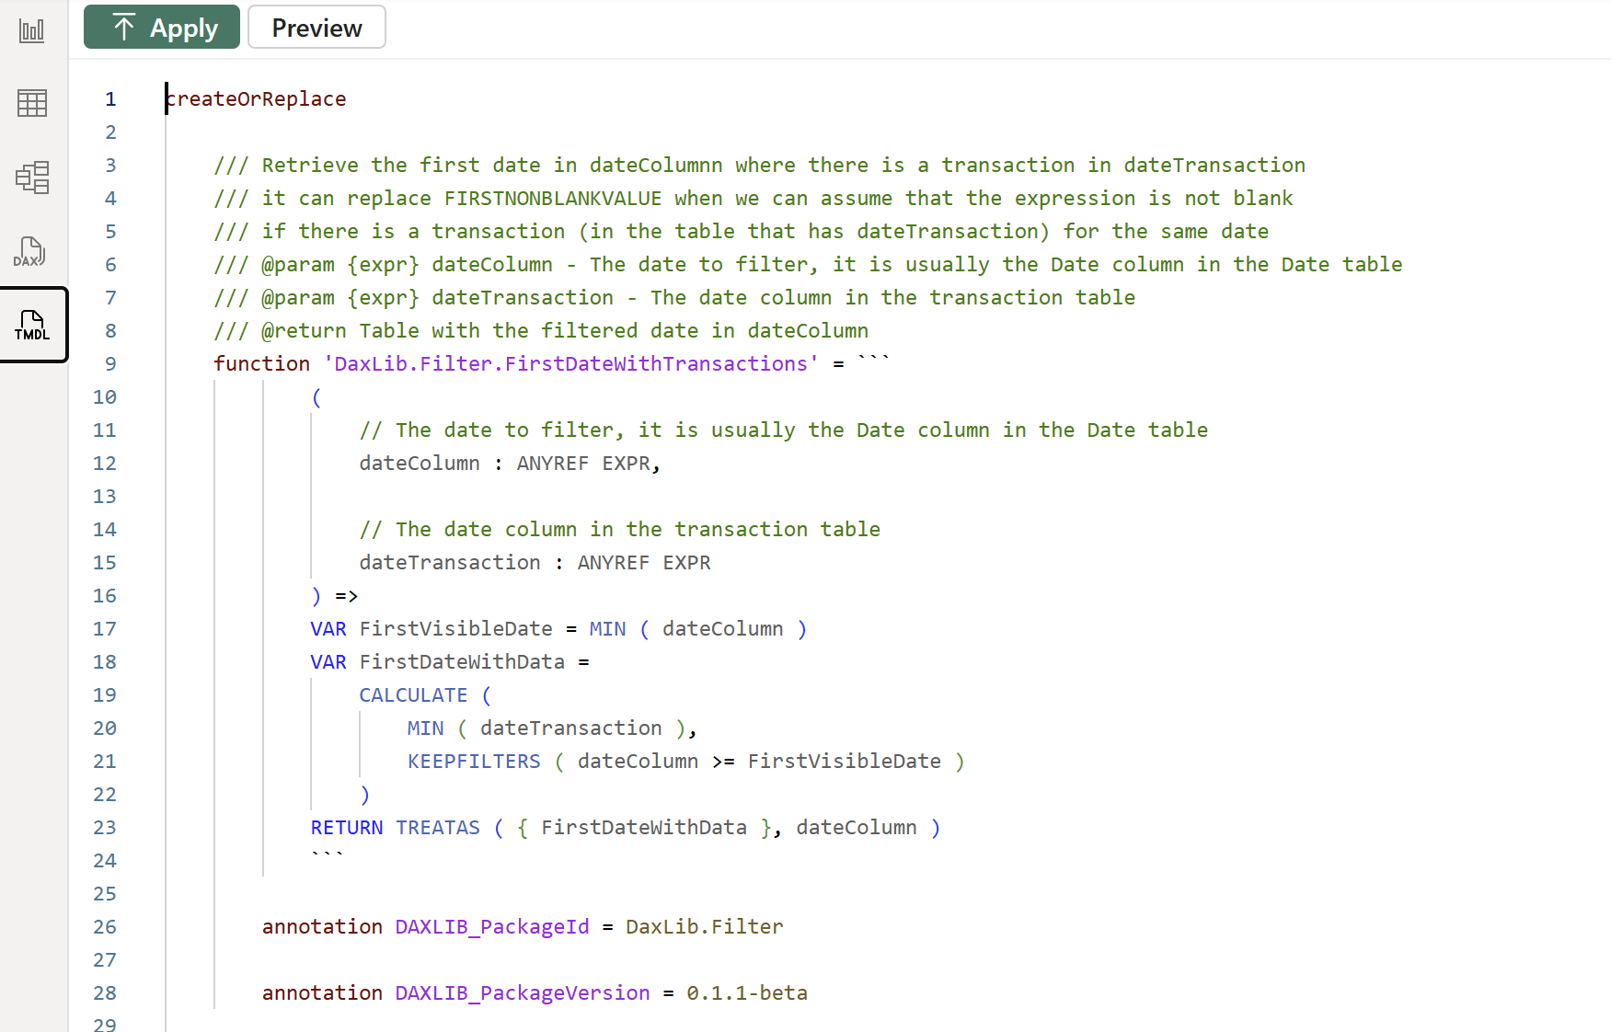
Enter DAX User-Defined Functions
First class model object (“Function”)
Can be created through…
DAX Query view
TMDL view

Slide 10
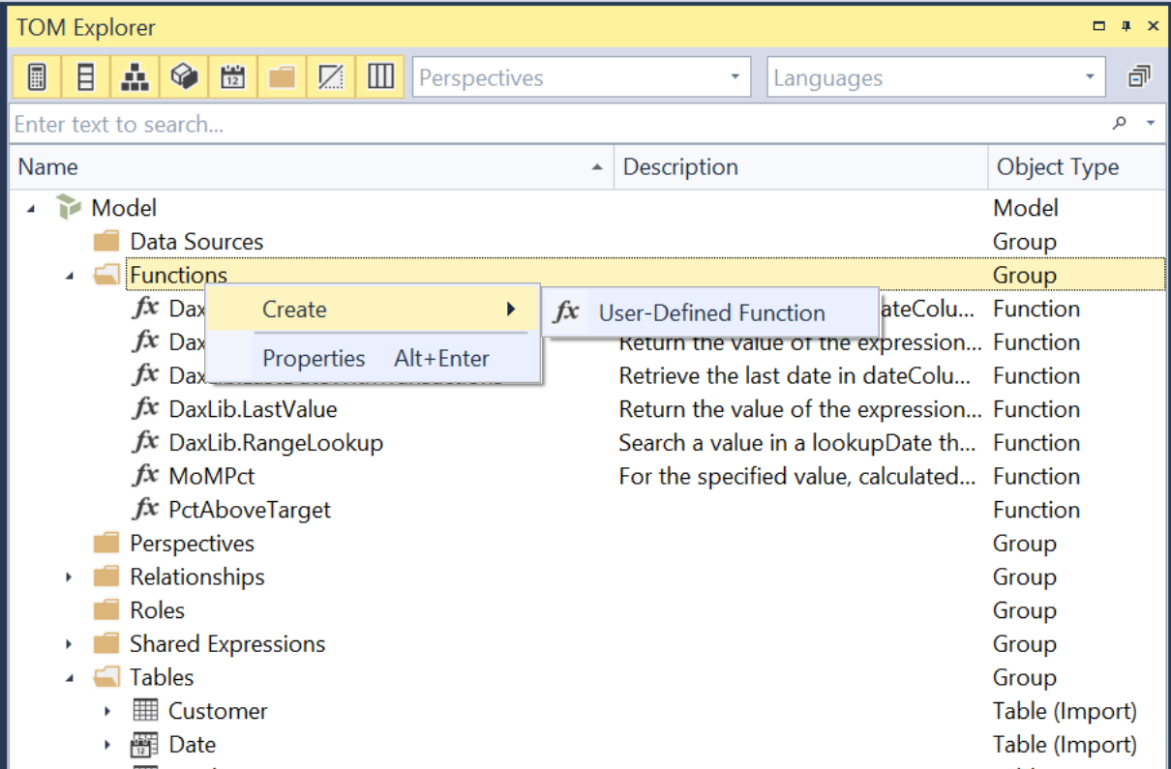
Enter DAX User-Defined Functions
First class model object (“Function”)
Can be created through…
DAX Query view
TMDL view
External tools

Slide 11
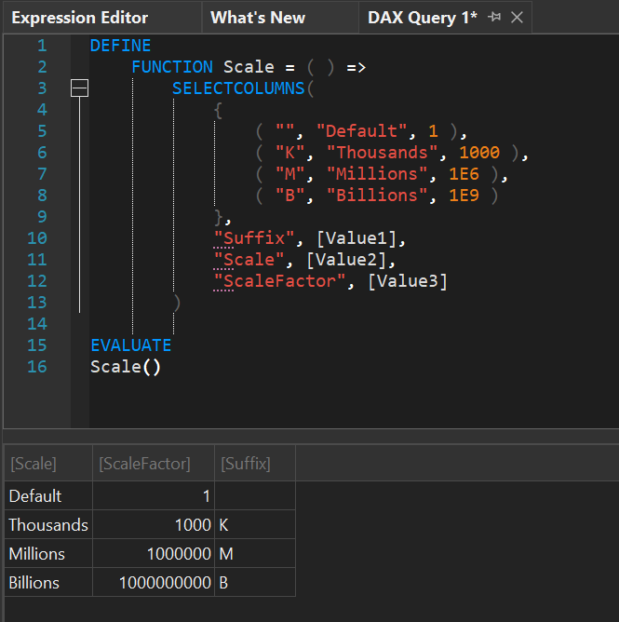
Enter DAX User-Defined Functions
First class model object (“Function”)
Can be created through…
DAX Query view
TMDL view
External tools
Can return scalar or table values

Slide 12
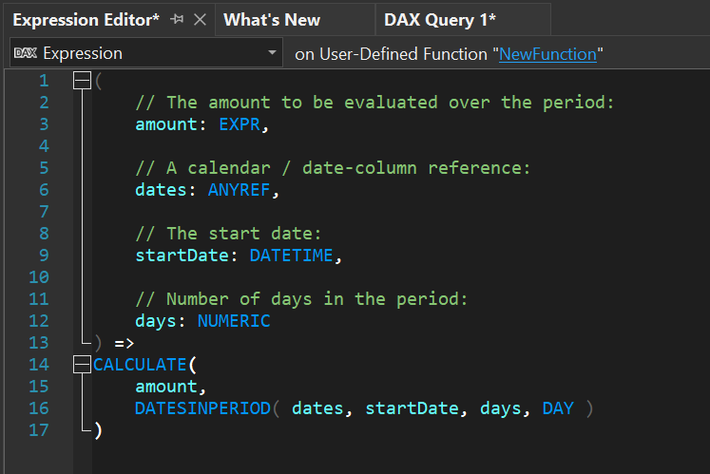
Enter DAX User-Defined Functions
First class model object (“Function”)
Can be created through…
DAX Query view
TMDL view
External tools
Can return scalar or table values
Parameters can be scalar or table values, or object references

Slide 13
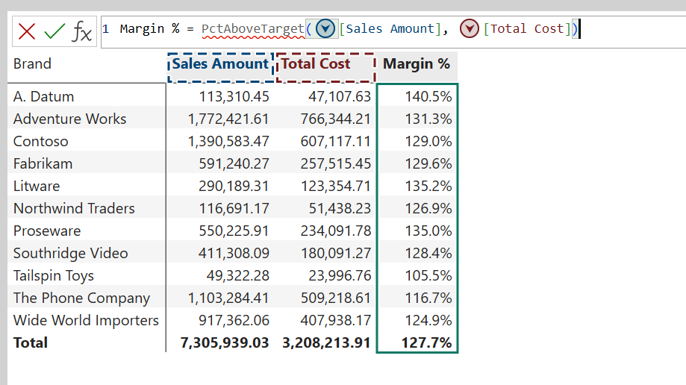
Enter DAX User-Defined Functions
First class model object (“Function”)
Can be created through…
DAX Query view
TMDL view
External tools
Can return scalar or table values
Parameters can be scalar or table values, or object references
Can be called from anywhere (including other UDFs and Visual Calculations)

Slide 14
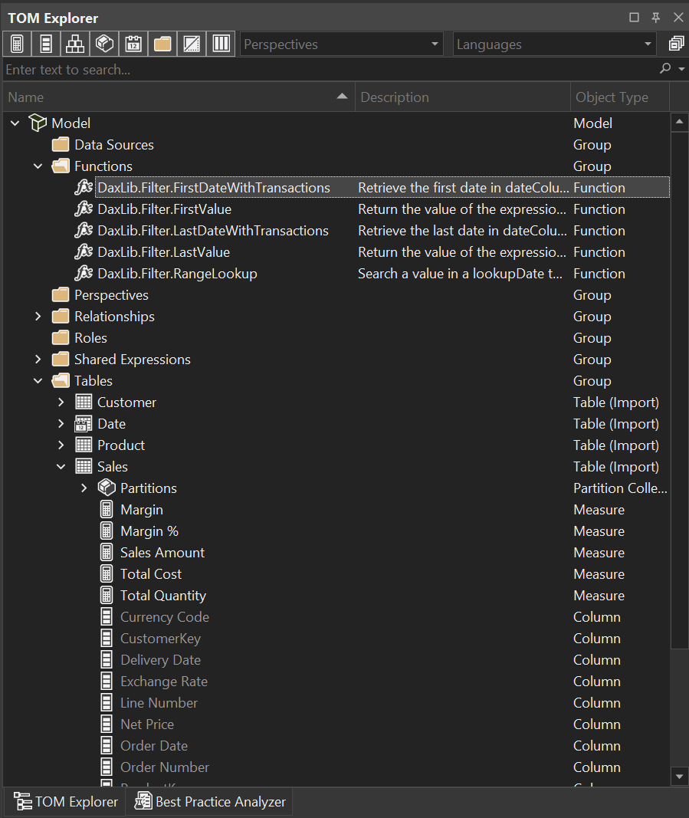
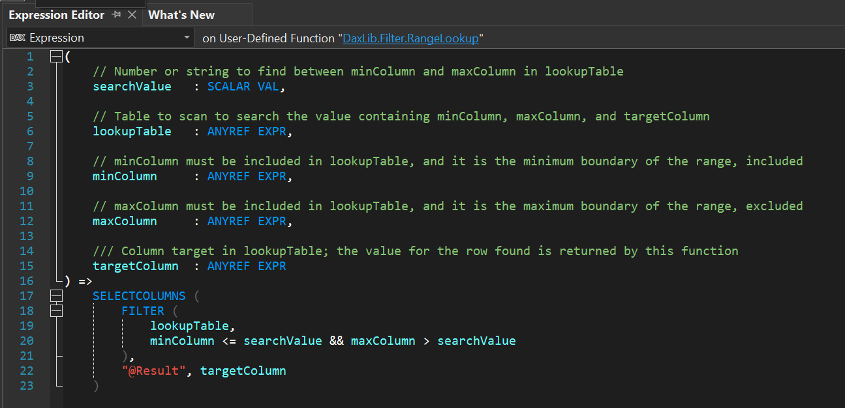
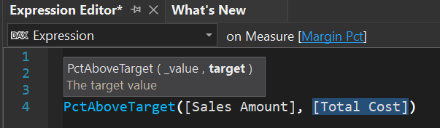
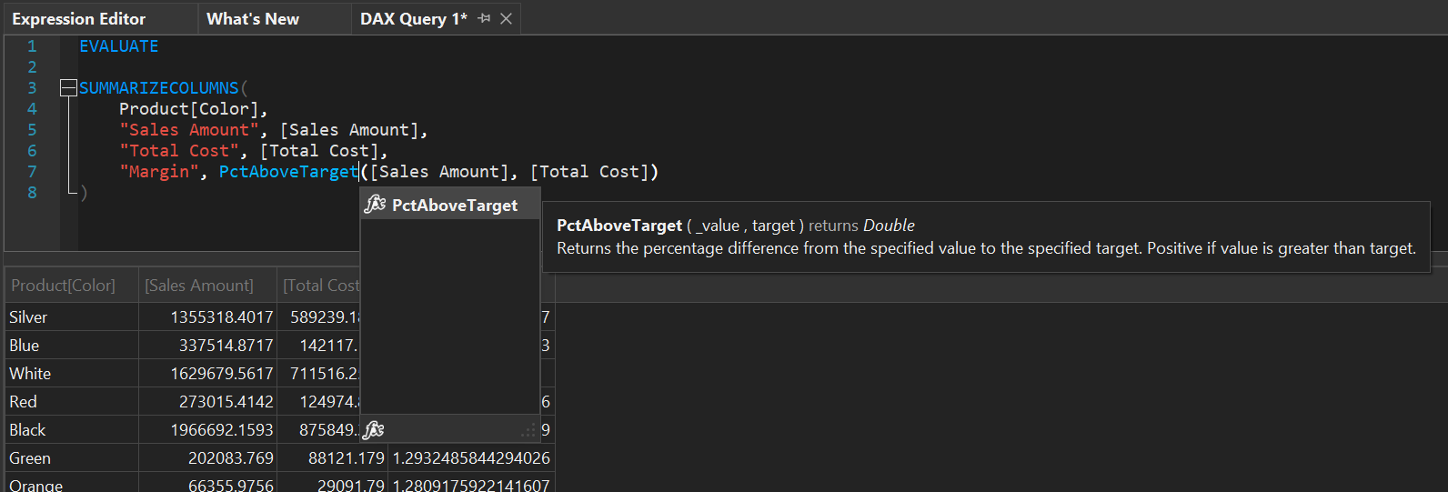
How do they work?
New type of model object: “Function”
Expressed using DAX
Can be called from any DAX expression…
…in other model objects (even other functions)
…in DAX queries
…in Visual Calculations
Can return scalar values or tables
Can have custom parameters
Scalar values
Tables
Object references
Expressions

Slide 15
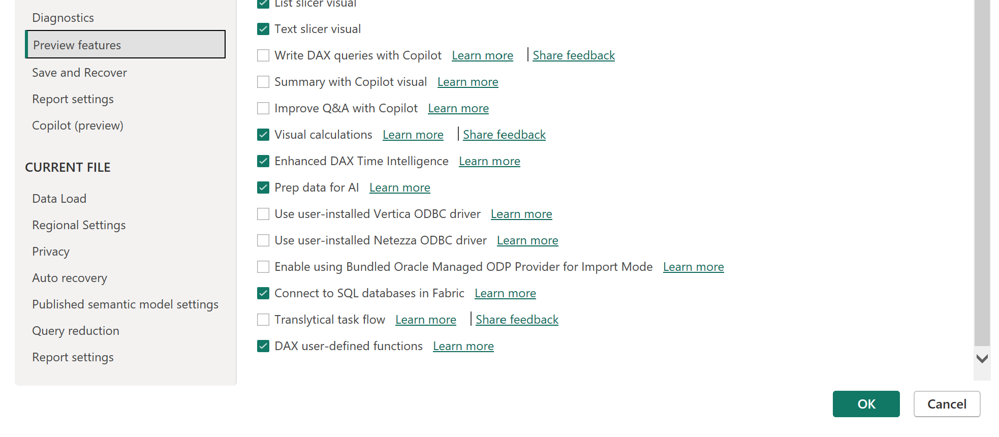
How do they work?
Enable preview feature
Compatibility Level 1702

Slide 16
Demo
Setting up and creating your first UDF

Slide 17
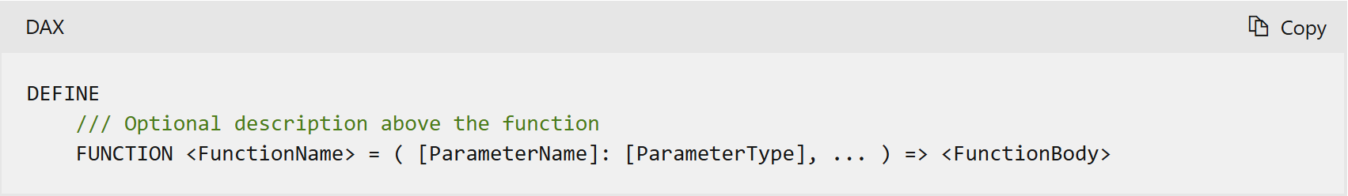
How do they work?
Function object properties:
Name
Description
IsHidden
Expression
Special syntax:
Note: Only the code after “=“ is stored in the Expression property
Notes:
IsHidden currently does nothing.
Description

Slide 18
Demo
Creating UDFs in external tools (Tabular Editor)
Notes:
Show in TE2 – demonstrate “Show dependencies” and “formula fix-up”

Slide 19
How do they work?
Invoke UDFs just like built-in DAX functions…
…in DAX queries
…in measures (model-scoped or report-level*)
…in calculated columns / tables
…in calculation groups
…in RLS filter expressions
…in Visual Calculations
*Buggy IntelliSense / UDFs currently do not show up in Model View while live connected to a model

Slide 20
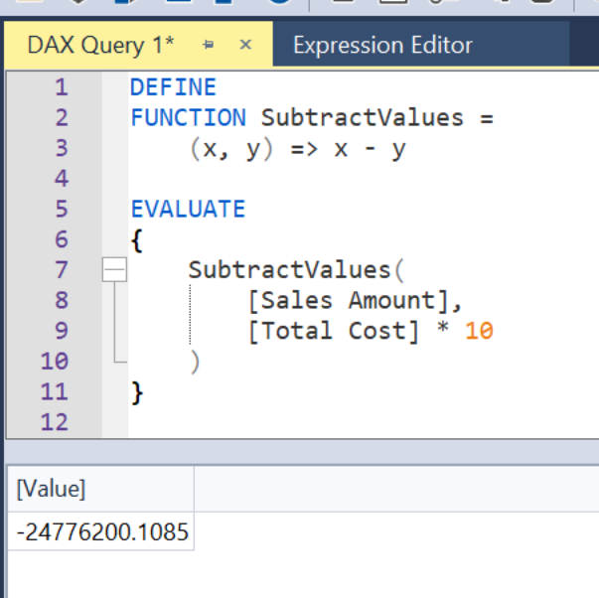
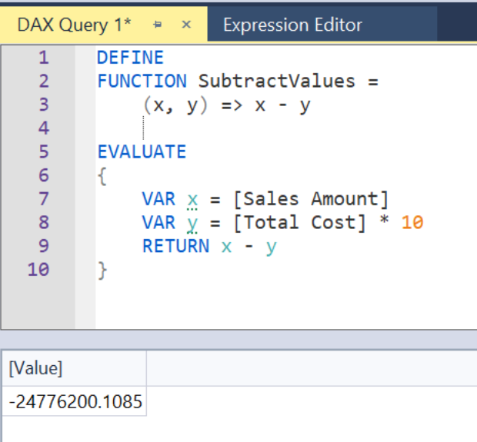
How do they work?
Helpful to think of them as “macro expansions” (aka. “inlined at runtime”)
Recursion not allowed!

Slide 21
Demo
UDF invocations and inlining
Notes:
Show demo 3 in TE3

Slide 22
Understanding parameters
Two types of parameters:
(Default) Value parameter (aka. “eager evaluation”)
Evaluated immediately when function is called
Passed to the function as a constant value (always produces the same result inside the function body)
Similar to how DAX variables work
Keyword: VAL
Expression parameter (aka. “laze evaluation”)
Can be object references or arbitrary DAX expressions
Evaluated in the evaluation context where it is being used in the function body
May produce different results inside the function
Keyword: EXPR

Slide 23
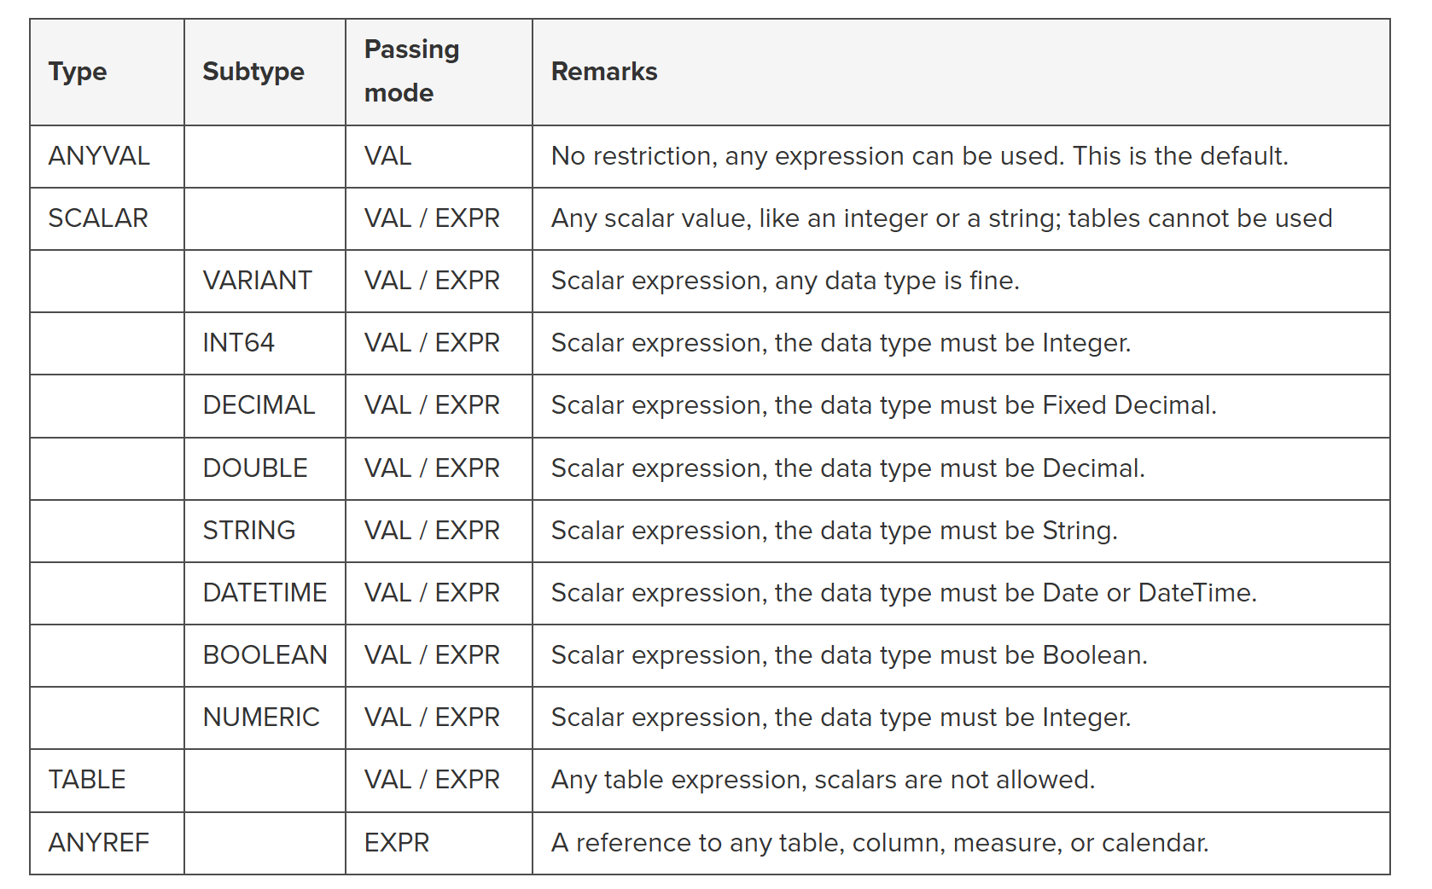
Understanding parameters
UDFs support 0 – 12 parameters
Optional parameters not supported
Function overloading not supported
Parameter type hints:
Type: AnyVal, Scalar, Table, AnyRef
Subtype (only when Type = Scalar): Int64, String, DateTime, Double, Decimal, Boolean, Numeric, Variant
Mode: Val, Expr
Credit: SQLBI, https://www.sqlbi.com/articles/introducing-user-defined-functions-in-dax/
Notes:
Underlined are defaults when omitted

Slide 24
Demo
UDF parameters
Notes:
Show Demo 4 in TE3

Slide 25
Gotchas / current limitations
Can retrieve UDF metadata through INFO.FUNCTIONS or DMV TMSCHEMA_FUNCTIONS
Currently no parameter metadata ☹
IsHidden does nothing
Cannot author UDFs in the Power BI service (unless using XMLA endpoint)
No UDF “display folders”
Buggy IntelliSense in PBI Desktop
DAX in UDF bodies is not updated when renaming objects in PBI Desktop
PBI Desktop doesn’t support parameter comments / tooltips

Slide 26
Demo
Real-life examples
Notes:
Dynamic format strings
SVGs

Slide 27
Community innovation
UDFs fall into two different categories:
Model specific
Model independent
The latter opens the door for logic reuse across models
daxlib.org: Launched by SQLBI. First community attempt at providing an open “marketplace” for UDFs
“Nuget for DAX”
Tabular Editor 2 and 3 integration planned!
Anyone can contribute!

Slide 28
Demo
DaxLib integration in TE3

Slide 29
Naming conventions / Best practices
UDF naming conventions:
Use PascalCase
Cannot use built-in function names or reserved keywords
Delineate categories using “.” (dots)
Similar to namespaces in other languages
Partial names cannot be reserved keywords
Ensures function names do not conflict with new built-in functions introduced in the future
Use “Local.” for model specific functions
Parameter naming conventions:
Use camelCase
Include suffix to indicate the expected type, i.e. “dateColumn”, “amountMeasure”, etc.
https://docs.sqlbi.com/dax-style/dax-naming-conventions#user-defined-functions

Slide 30
In conclusion
UDFs are powerful new constructs in DAX
Allows simple logic encapsulation and reuse
Cleaner models that are easier to maintain
Clearer path towards unit testing of semantic model logic
No side effects
Enables logic sharing across models
Community already doing amazing things with UDFs!

Slide 31
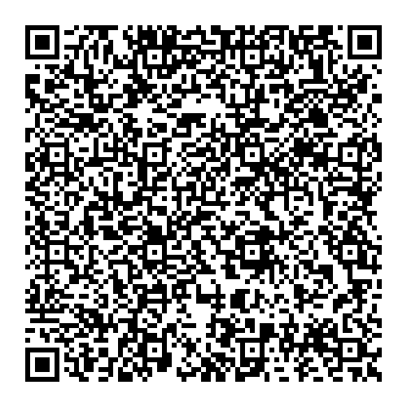
Thank you!
Don’t forget the session evaluation:

